Slide 1
Chatterly website
Revolutionizing Academic Success with AI

Slide 2
Chatterly Features
Dashboard
Chat
Upload
Solution
Dark and Light Mode
Settings

Slide 3
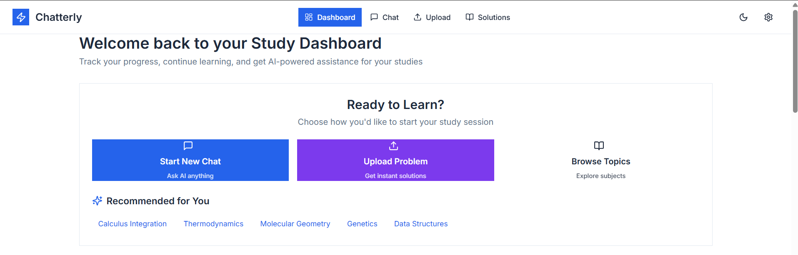
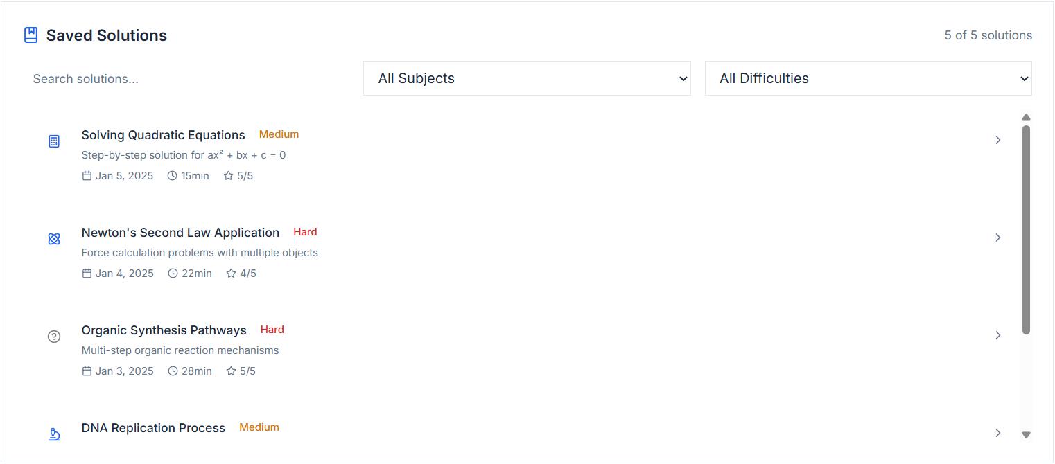
Dashboard Overview
Start New Chat
Upload Problem
Browse Topics
Saved Solutions

Slide 4
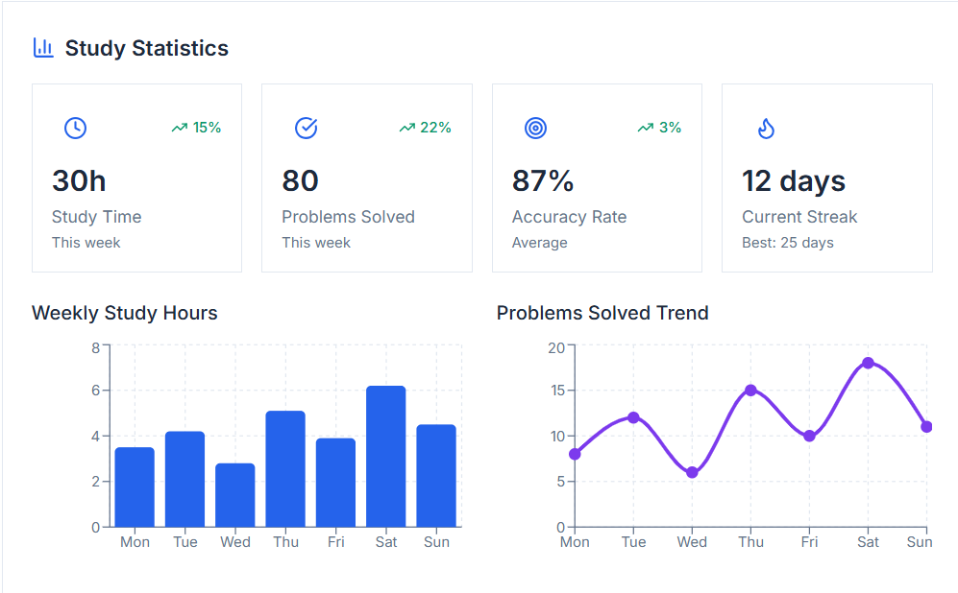
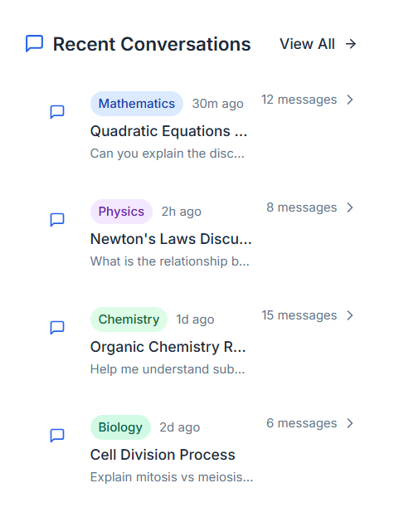
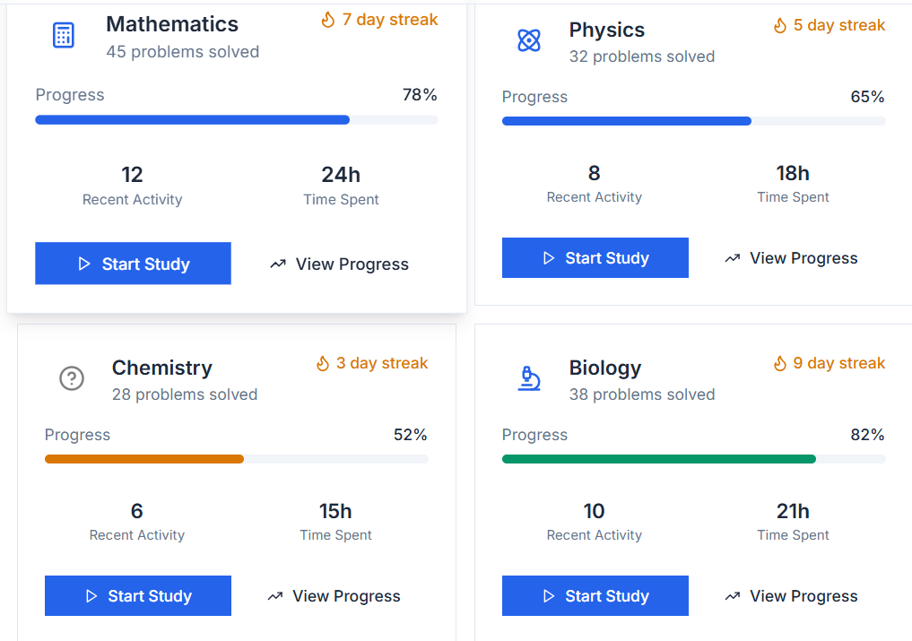

Study Statistics
Subject-Specific Progress
Recent Conversations
Need Help?

Slide 5
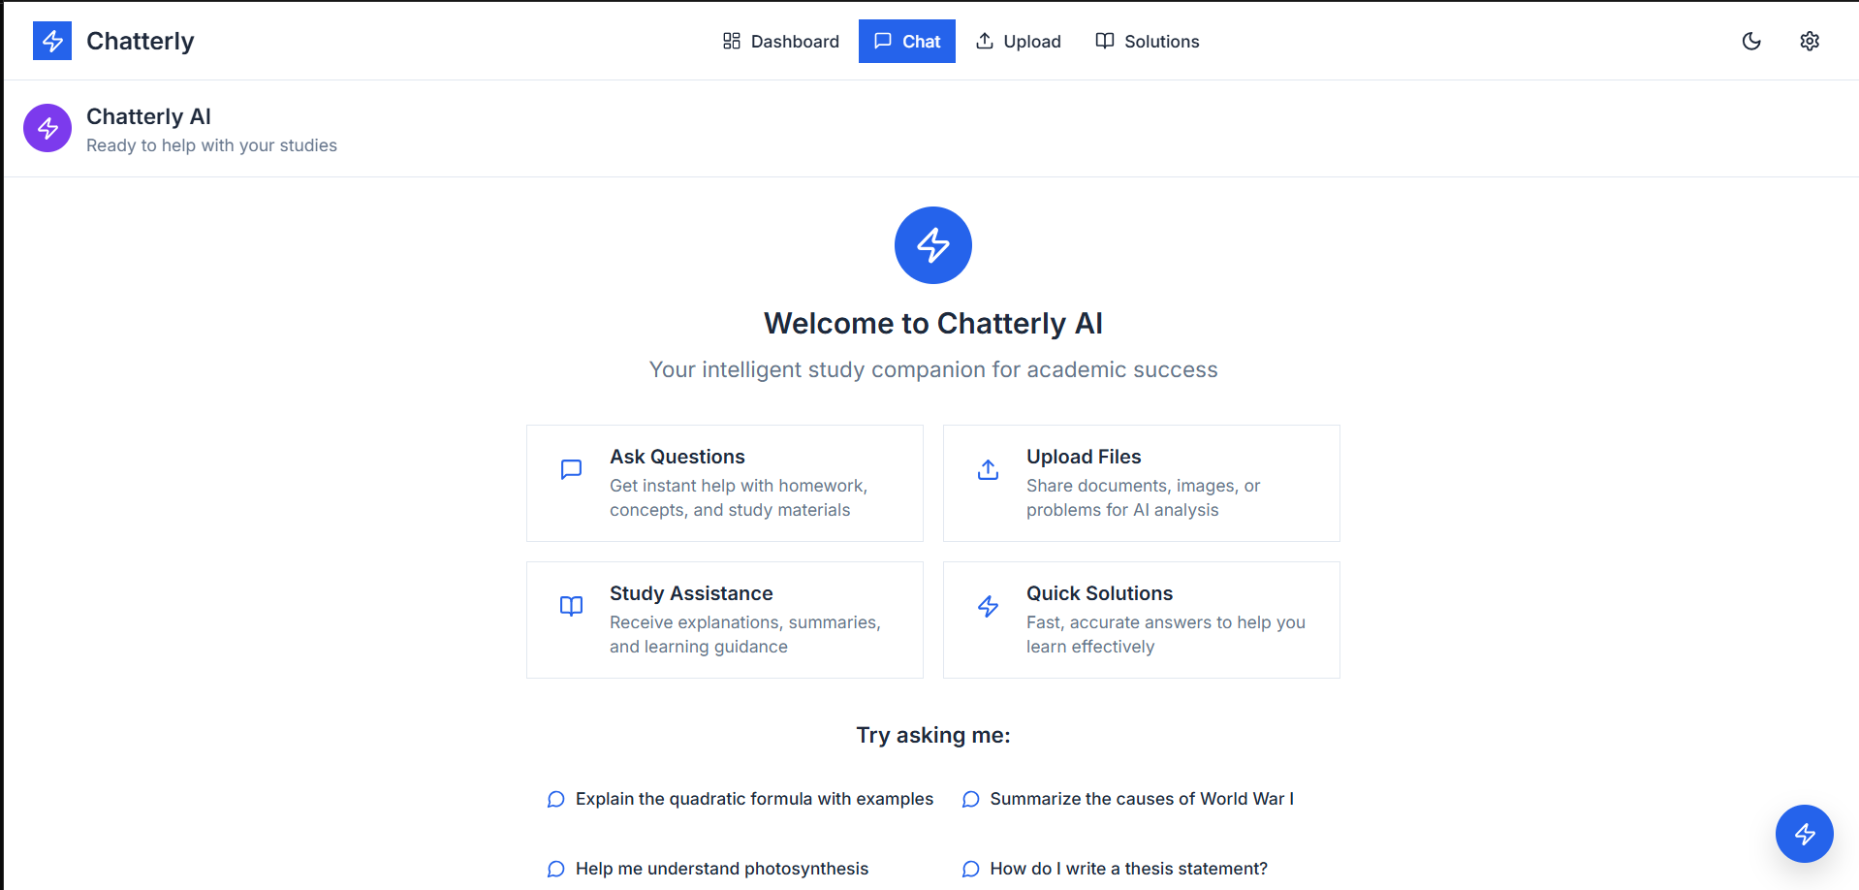
Chat Overview
Ask Questions
Upload Files
Study Assistance
Quick Solutions

Slide 6
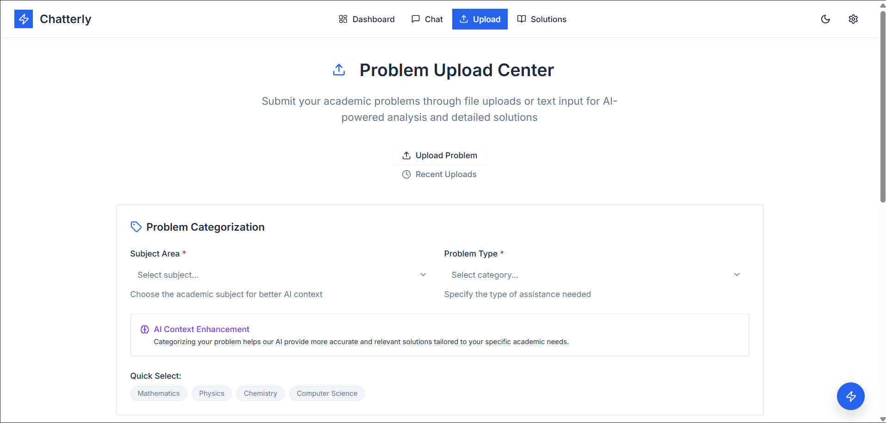
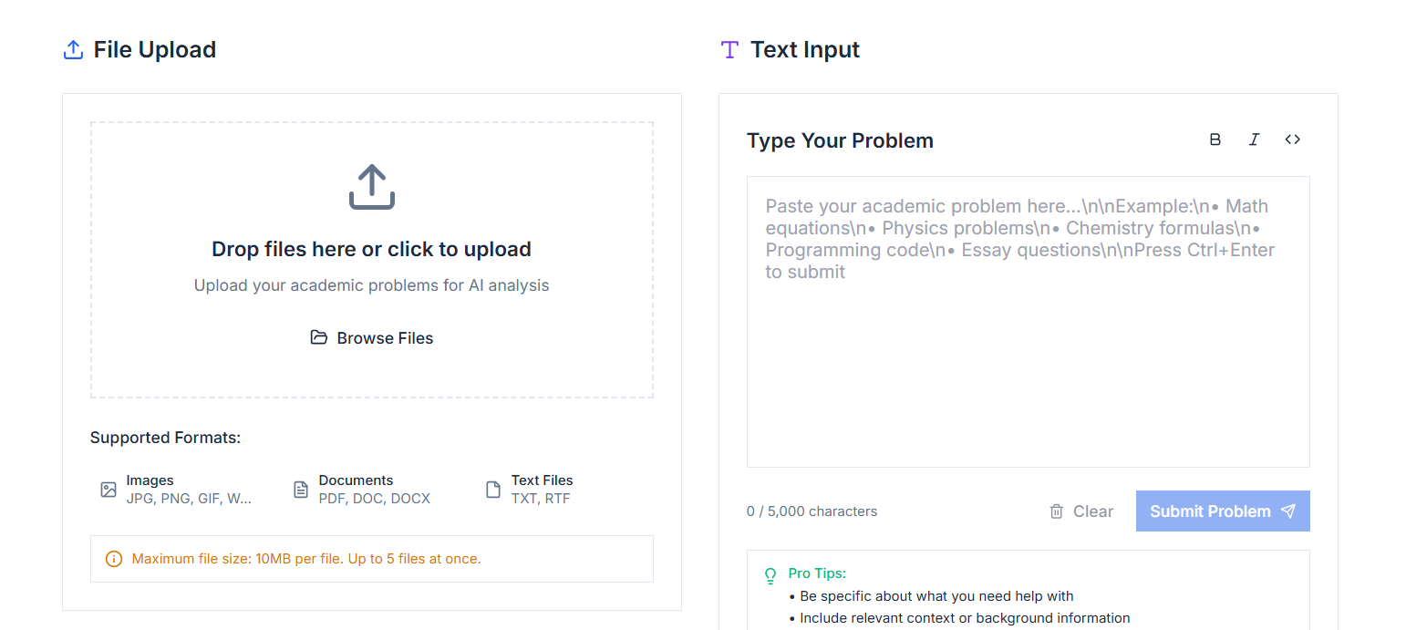
Upload Overview
The Problem Upload Center
File Upload
Text Input
AI Context Enhancement
Required Fields
Quick Select Buttons
Key Tips

Slide 7
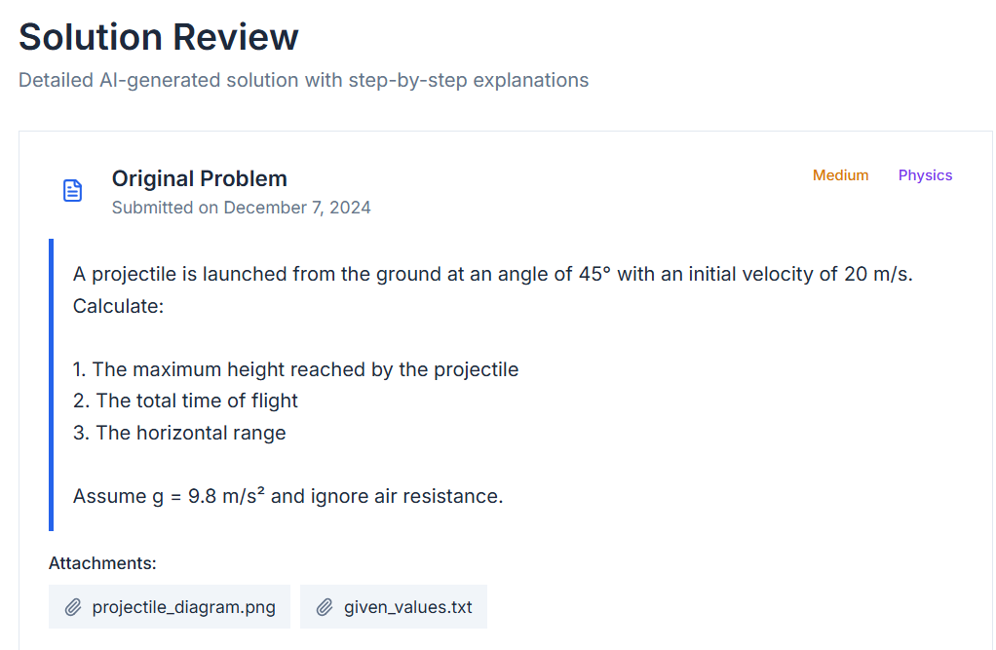
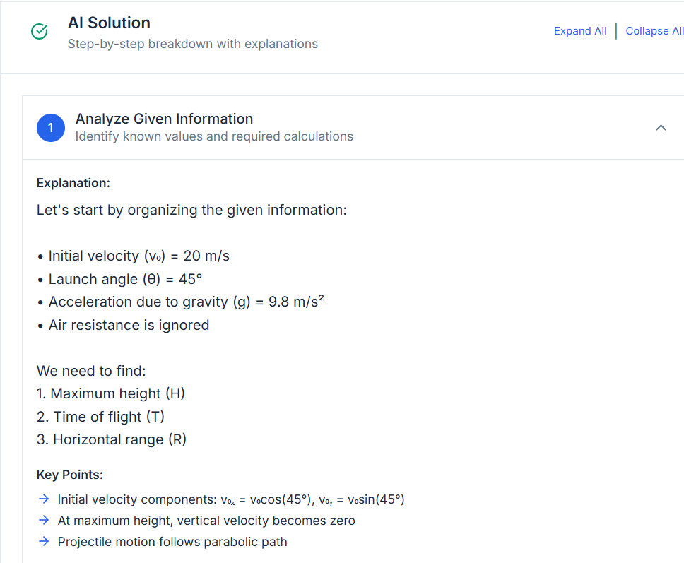
Solution Overview
Original Problem Display
AI Solution (The Core)

Slide 8
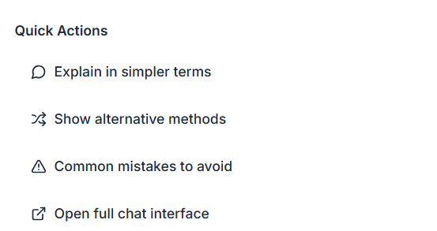
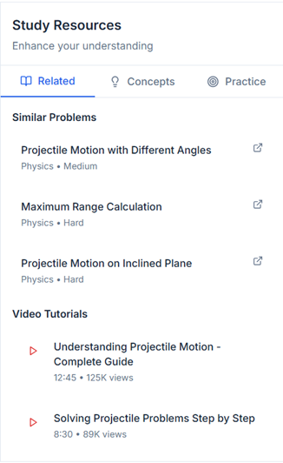
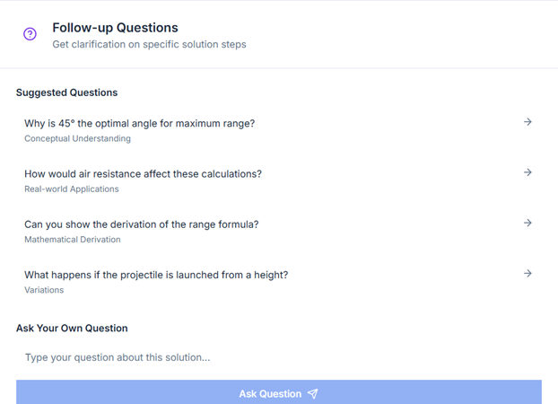
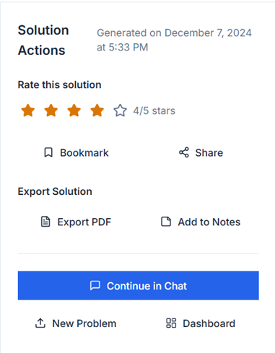
Quick Actions
Follow-up Questions
Study Resources
Solution Actions

Slide 9


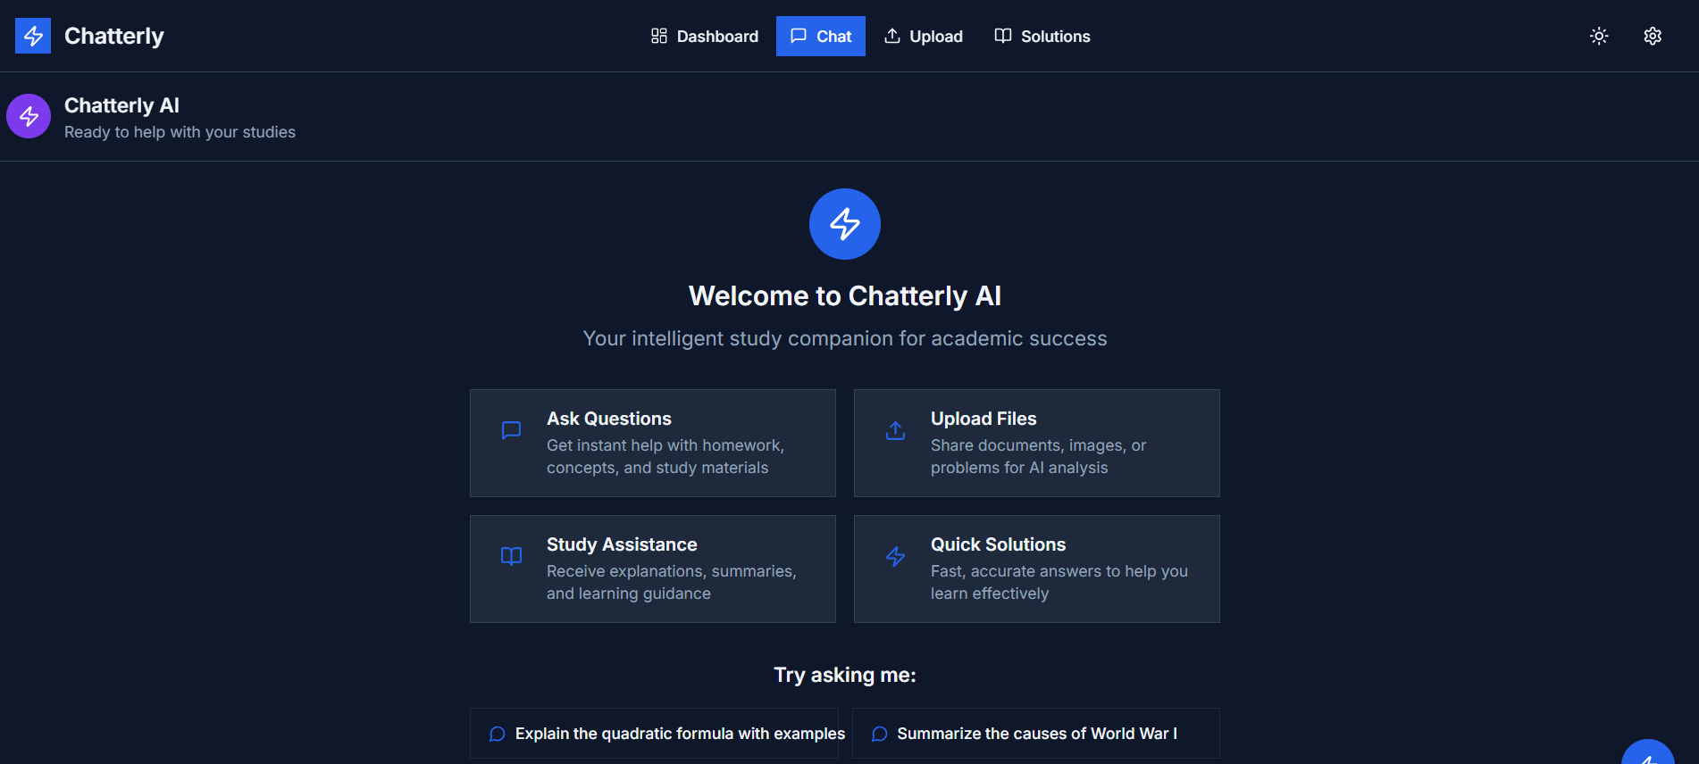
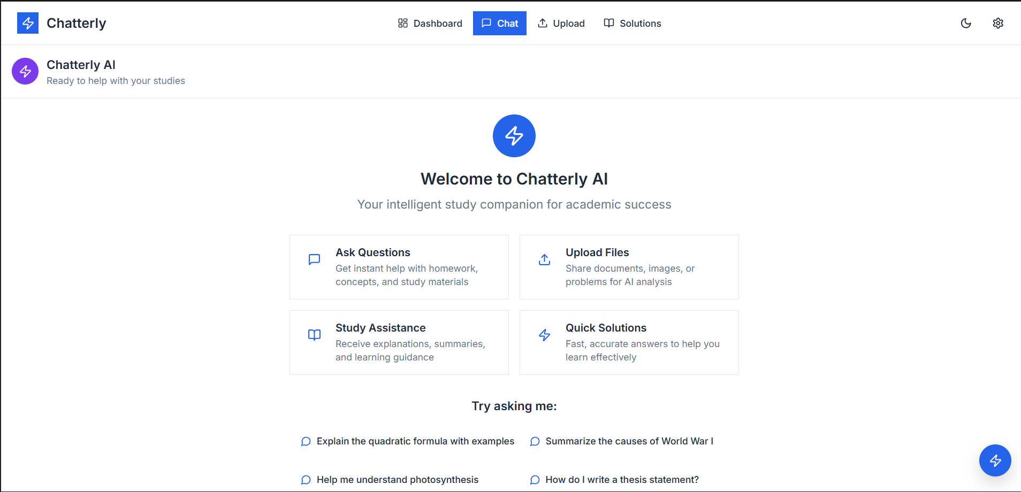
Dark and Light Mode
DARK MODE
LIGHT MODE

Slide 10
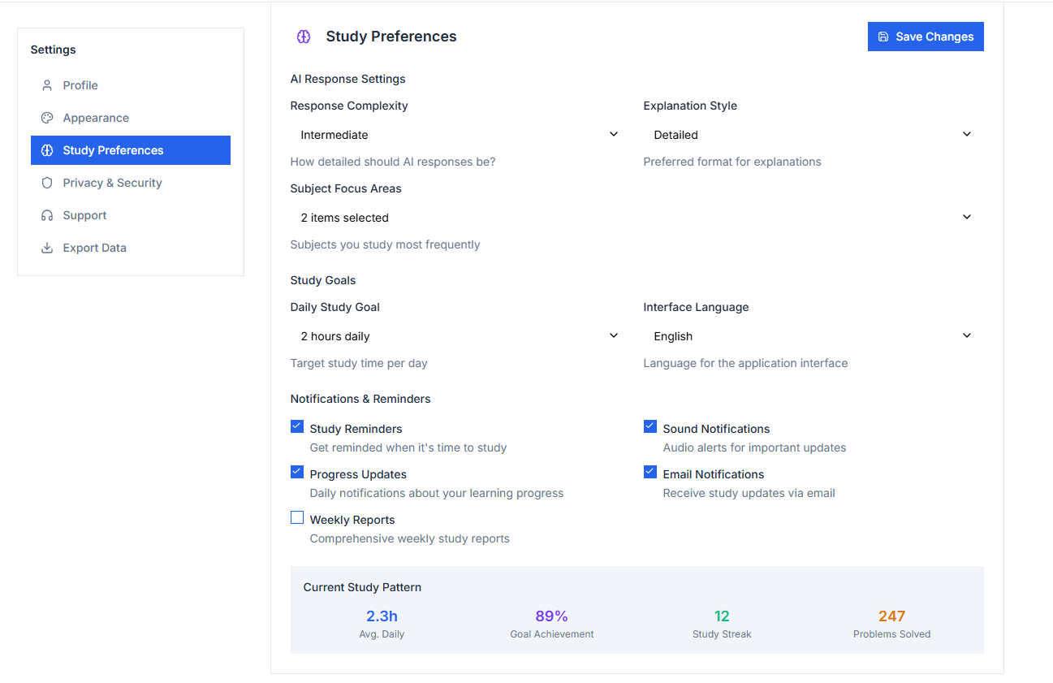
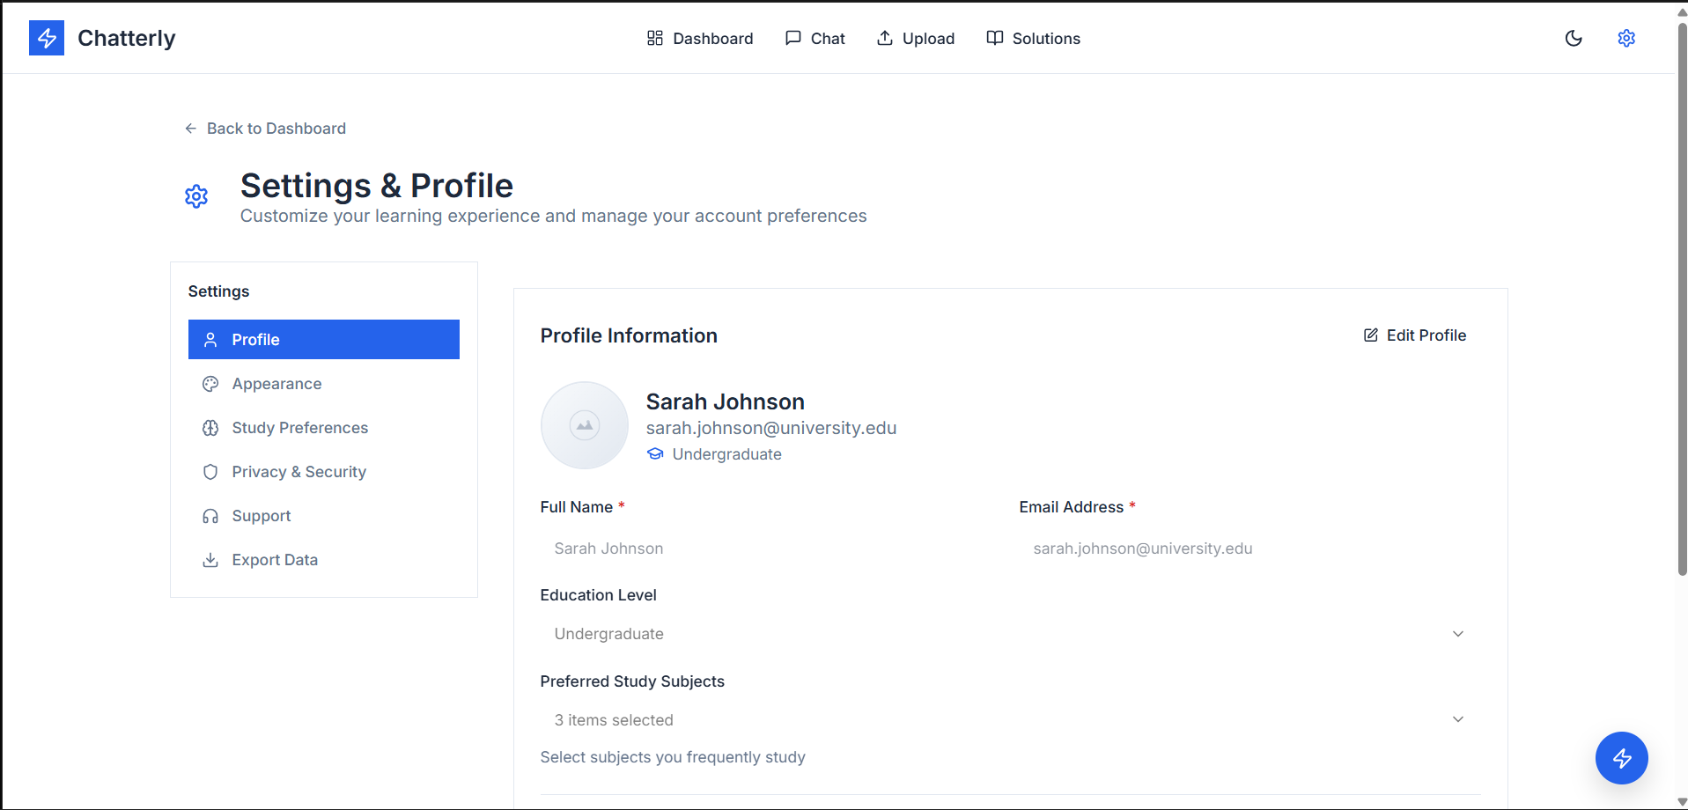
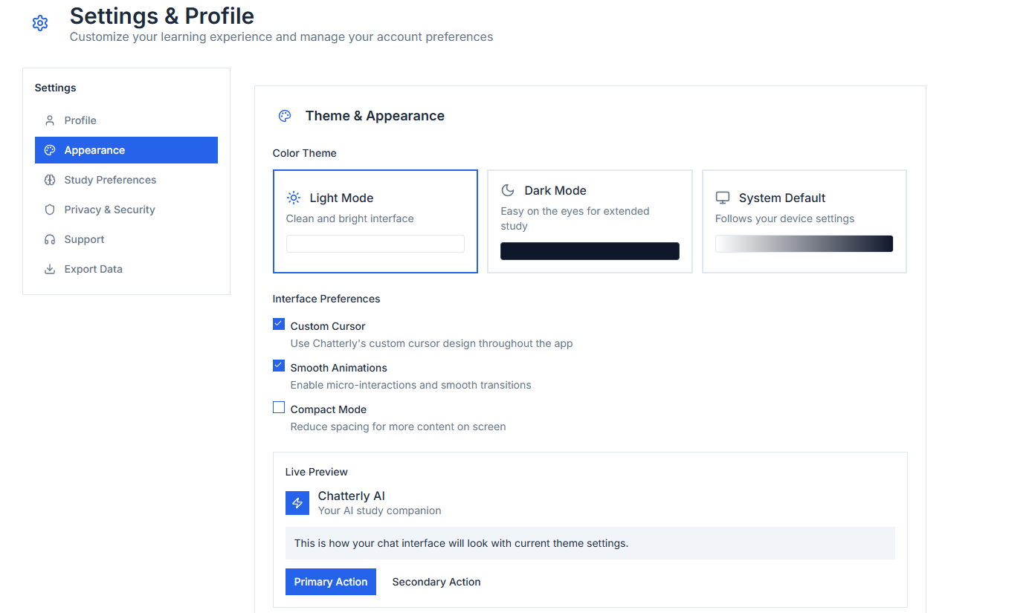
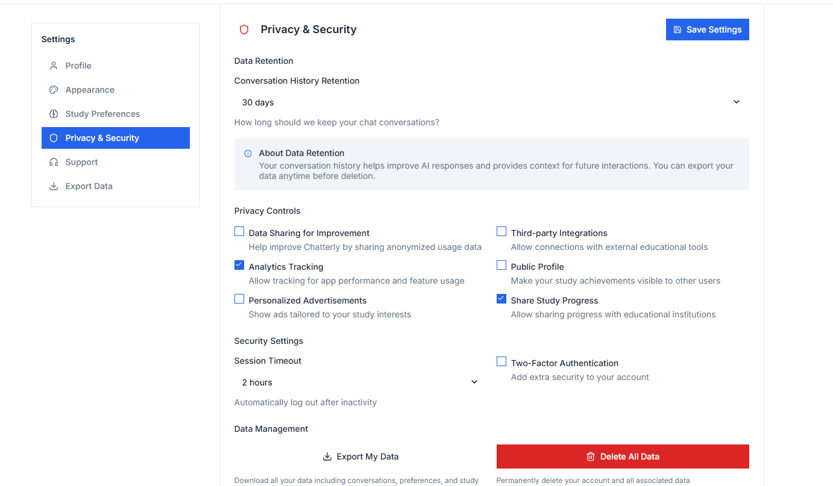
SETTING OVERVIEW
Profile
APPEARANCE
Study Preferences
Privacy & Security

Slide 11
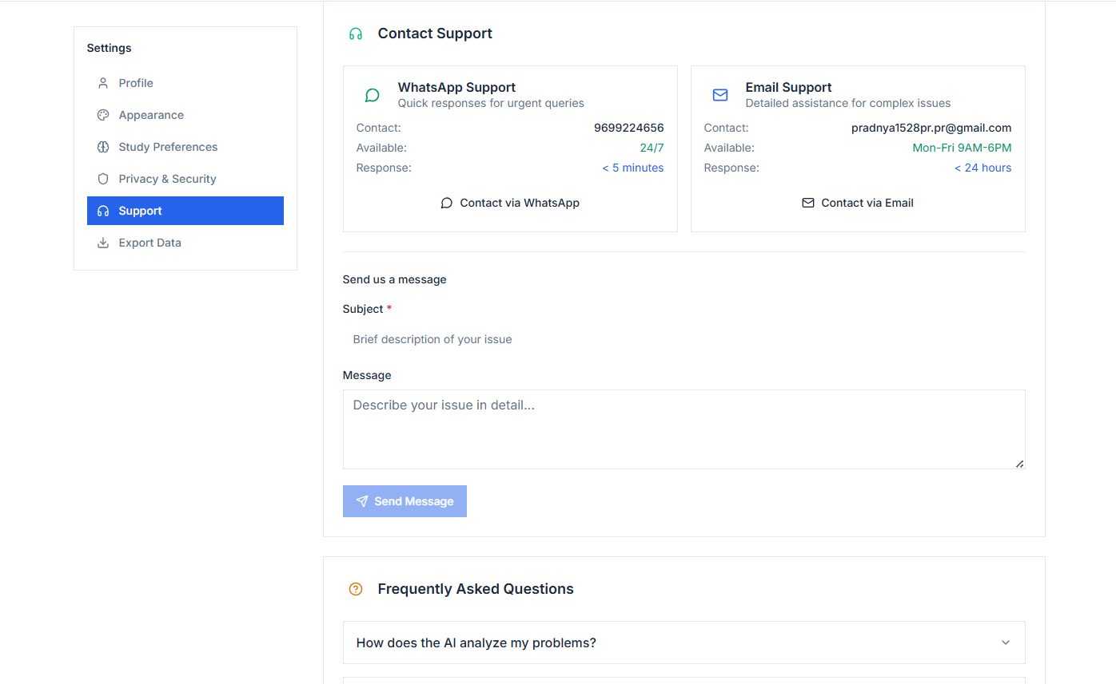
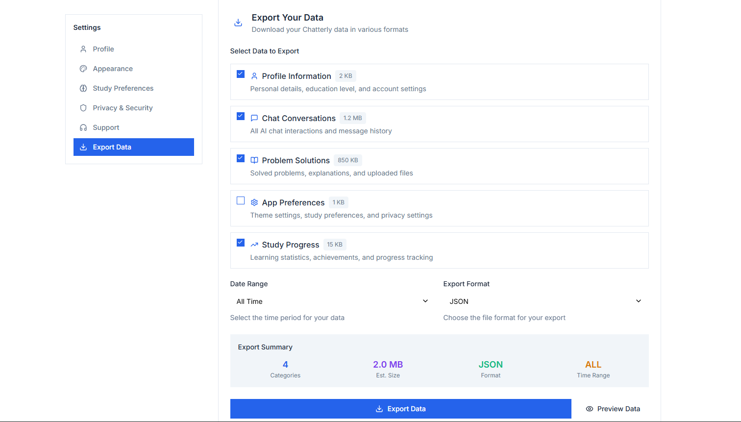
Support
Export Data

Slide 12
THANK YOU !!

